Slide 1

Open Data Pilot Workshop
Adam J. Martin, Open Raleigh Manager
@OpenRaleigh

Slide 2
Agenda
Intro & Open Data Context (20 min)
Stakeholder Profiles (20 min)
Data Stories Ideation (45 min)
Data Inventory (1-2 hr)
Notes:
What are we working with?

Slide 3
Introductions
Our Journey today
What Works Cities Initiative
Stormwater
Human Centered Design

Slide 4
Vision for
Raleigh. By the people, for the people.
Make trusted data flow within the city and to citizens to enable 21st century digital services and democratic empowerment.
through open data, analytics, visualizations, real-time updates, new technologies and issue-driven partnerships.
Notes:
Help citizens answer
What does our government do exactly (the details)?
How does it make decisions?
Where’s the info I need to run my business better?
How can I participate digitally?

Slide 5
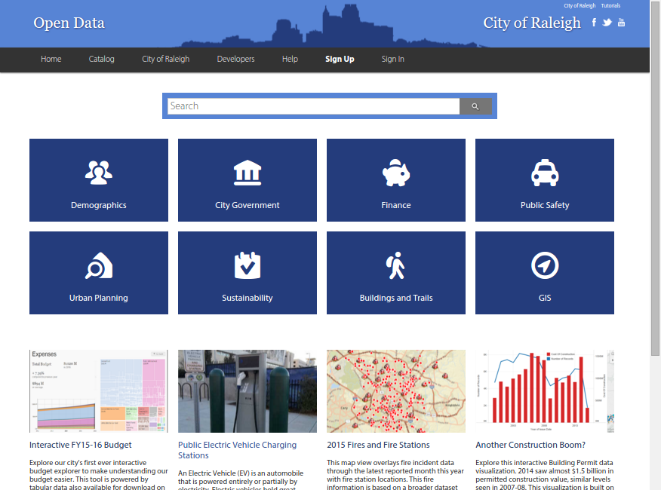

Slide 6
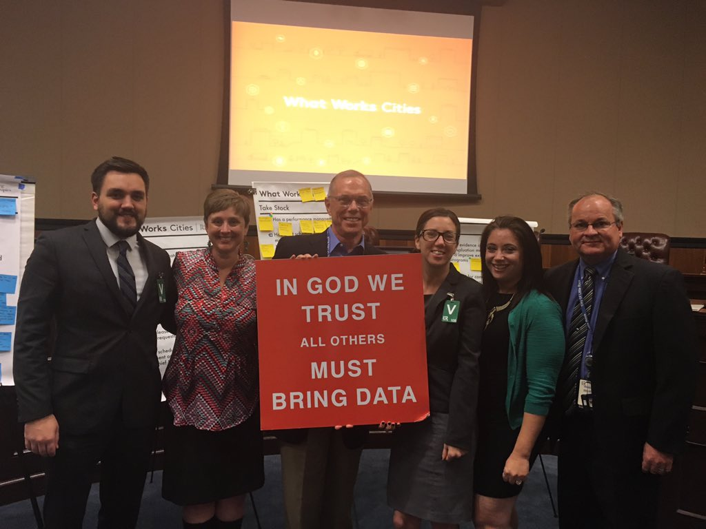
What Works Cities
An initiative of Bloomberg Philanthropies designed to accelerate cities’ use of data and evidence to improve people’s lives.
Driven by world-class partners for world-class cities:
Results for America
The Center for Government Excellence at Johns Hopkins University
Sunlight Foundation
The Government Performance Lab at the Harvard Kennedy School
The Behavioral Insights Team
Notes:
➤Mission: Evaluate and accelerate a city’s use of data and evidence to engage their communities, make government more effective, and improve people’s lives
➤Provides: Technical support, access to expertise, peer-to-peer learning to help cities better use data and evidence to engage the public, evaluate progress, and fund “what works”
➤ Work on 4 different things related to data – open data, performance and analytics, results driven contracting, low cost evaluation

Slide 7
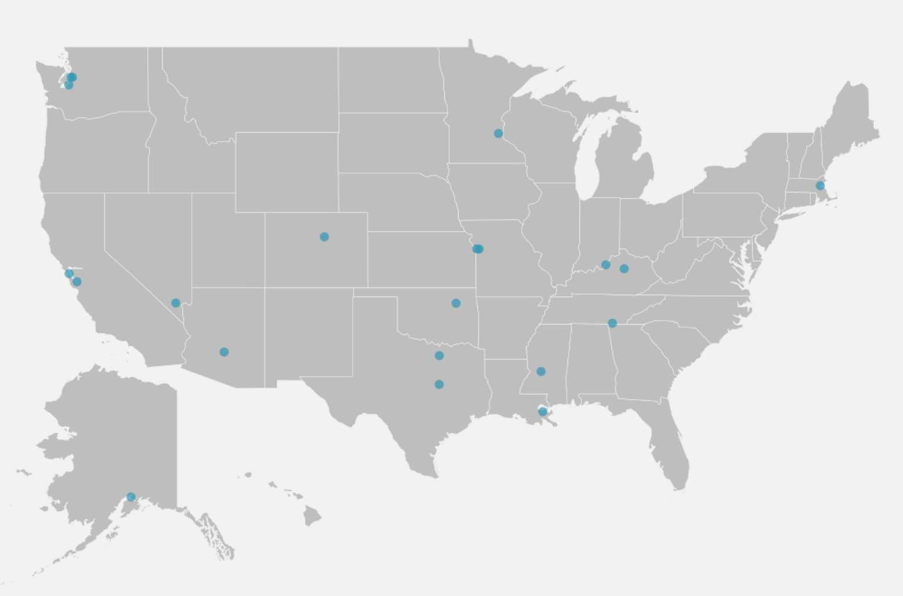
What Works Cities
Create a movement
31 cities currently active
Over 140 applied to join
Most focus on open data and performance management
Work in Raleigh
Standardize process and policy for the inventorying and release of data
Link management practices and timelines to the city’s strategic plan
Notes:
➤100 mid-sized cities – between 100,000 & 1,000,000,000
➤Selected as part of second round of cities
➤Conducted an assessment in October 2015
➤Two major areas were identified for improvement: Performance Management and Open Data
➤120 day engagement from February through June

Slide 8
What is Open Data? Classifications
Open Data
Non- Digital
Public Record
Sensitive
DigitalData
Protected / Exempt
Confidential
Physical Nature
How Info is stored
Legal Nature
Who has right to the Data?
Access Nature
How data is provided by default?
Notes:
Legal Nature: In 1995, NC passed public record laws Chapter 132
http://www.ncga.state.nc.us/enactedlegislation/statutes/html/bychapter/chapter_132.html
Open data is about how proactively and easily we make our data available for the public, and putting the data out in a way that makes it easier for companies and technologists to add value to the data.
We recognize that for some data, we may not want to lower the bar to 0 for access because departments. We propose

Slide 9
The Data Stack
Our focus
Presentation
PDF Reports, Interactive Dashboards, Custom Apps, Embeds to Websites
Access Datasets
Structured Views [Internal vs External, API access]
Storage Data Sources
Relational Tables; Unstructured [Retention]
Collection (Digital) Software User Interfaces
Transactions, logs
[Ownership]
People and Activities
Not all activity is captured or stored digitally as data

Slide 10





Outcomes of Data Ubiquity
Better Decisions
Digital Services
Increased Quality
of Life
Efficient City
Services
New Business Models
Notes:
Hypothesis
Chicago, IL: Over a nine month period, its Department of Public Health (CDPH) experienced a 65% drop in the number Freedom of Information Act (FOIA) requests for environmental records by making the data available on the city’s open data portal. Open Data Annual Report 2013
Montgomery County, MD Reduced overtime expenses by more than $46 million since 2008.
Baltimore, MD Utilized data to minimize risk of double paying city contractors, saving the City $300,000.
New York, NY
Increased the rate of detection for dangerous buildings that are highly likely to result in firefighter injury or death.
Doubled the hit rate for discovering stores selling bootlegged cigarettes.
Louisville, KY
Removed more than two hundred days from key administrative processes, like hiring.
Reduced unscheduled overtime and workers’ compensation expenditures by more than $2 million.

Slide 11
Why Open Data - Internal?
Government Employees
Dept. Mgrs, Analysts, Liaisons, Field
Government Leaders
City Managers, Council, Dept. Heads
Time Savings on boring tasks: Reduce time finding and collecting relevant data for your job
Better tools to reduce time analyzing relevant data
Reduce reporting time
Budget Justification: Easier time justifying resource requests
Improve Outcomes: Discover new data from other departments that can benefit your services / dept outcomes
Extra help: Enable others to analyze & solve problems
Recognition: From higher ups in COR, and potential for national recognition in your field
Increased public trust and satisfaction which can build social capital for other initiatives
Cost savings: enabling better use of smart management software tools to identify waste and ineffective processes
Attract Investments: Reduce friction for real estate developers and corporate HQ hunters
Attract Entrepreneurs & Corporations: OD can fuel new business models/value added solutions
PR: Improve rankings in innovation and openness

Slide 12
Proven Value - Anecdotes
Efficiency
Chicago, IL
Environmental Data: Department of Public Health (CDPH) experienced a 65% drop in the number Freedom of Information Act (FOIA) requests for environmental records by making the data available on the city’s open data portal. Open Data Annual Report 2013
Montgomery County, MD
Finance Data: Reduced overtime expenses by more than $46 million since 2008.
Baltimore, MD
Finance Data: Utilized data to minimize risk of double paying city contractors, saving the City $300,000.
New York, NY
Inspections/Fire/311: Increased the rate of detection for dangerous buildings that are highly likely to result in firefighter injury or death.
Police/Licenses: Doubled the hit rate for discovering stores selling bootlegged cigarettes.
Louisville, KY
Removed 200+ days from key administrative processes, like hiring.
Reduced unscheduled overtime and workers’ compensation expenditures by more than $2 million.

Slide 13





Getting Data to People
Quality
of Life
Map and Travel Apps
Public Transit (GTFS) & Bike Paths/Greenways
Road Closures

Slide 14

Data-Driven Performance
Better Decisions
Saved $13.2 million in first year.
Overtime fell by 40% within the program’s first 3 years
DVStat on domestic violence boosted delivery rate of temporary protective orders from ~ 30% to 70%.
DVStat provides data on the following topics:
Lethality assessments
Domestic violence arrests
Domestic violence warrants
Protective Orders
Domestic violence case dispositions and outcomes
Notes:
Outside of the police department, overtime fell by 40 percent within the program’s first three years, and absenteeism plummeted by as much as 50 percent in some agencies. has produced over $300 million in positive financial benefits. DVStat, which brought city and state law enforcement agencies together with domestic violence groups such as the House of Ruth. The goal, the mayor said, was "a stronger system-wide response to repeat abusers.” Lennig said the group successfully addressed the problem of delivering temporary protective orders. Failure to serve the orders would often result in a dismissal, endangering victims. The group recommended shifting delivery from the Police Department to the sheriff, which helped boost the delivery rate from about 30 percent to 70 percent.
brought city and state law enforcement agencies together with domestic violence groups such as the House of Ruth. Successfully addressed the problem of delivering temporary protective orders. Failure to serve the orders would often result in a dismissal, endangering victims. The group recommended shifting delivery from the Police Department to the sheriff, which helped boost the delivery rate from about 30 percent to 70 percent.

Slide 15
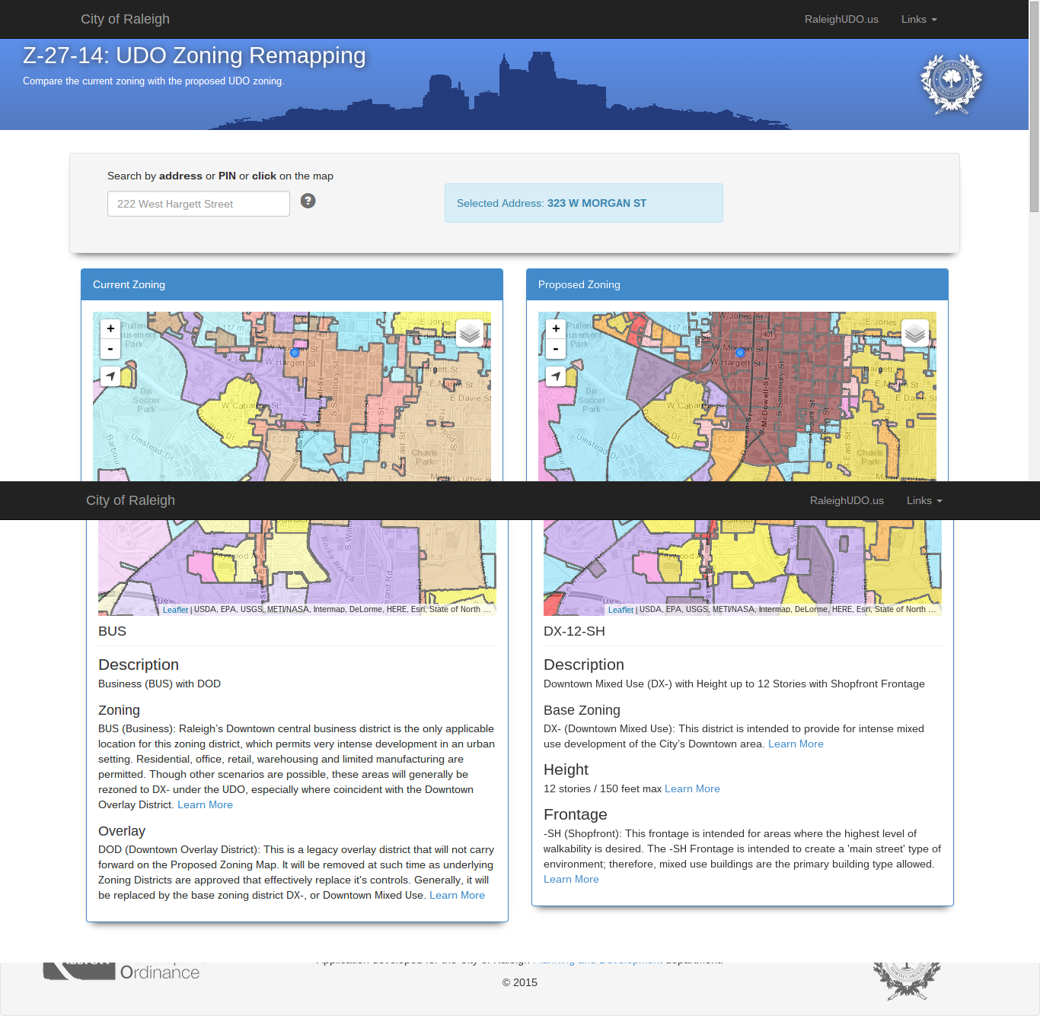
CoR Data-Powered App for Citizens
Rezoning Website:
Target Users
Citizens
Real Estate Developers
Data Used
Proposed UDO Re-Zoning
Existing Zoning
Citizen Usage
Launched May 2014 with Public Comment period
36,000 page views*
16,300 users*
5.15 min avg session duration*
* Google Analytics as of July 15 2015
Application: http://maps.raleighnc.gov/remapping/
Notes:
In 2014, Raleigh initiated a complete re-zoning effort to modify its Unified Development Ordinance. This ambitious effort covered more than a third of the City’s land area and nearly 35,000 parcels. The comment period on the initial draft zoning map occurred between May 19 and September 30, 2014. As part of that effort, it release a the data file a citizen oriented application for exploring the the Future Land Use proposed Zoning to be compared with the Existing Zoning
The application launched in May 2014 and has 36,000 page views and 16,300 users with an avg of 5.15 min session duration. City staff received, analyzed and responded to 1,750 comments. The Planning Commission’s recommendation for the zoning remapping was approved on April 14, 2015, and the data and application is still being used today during City Council review before final adoption.

Slide 16
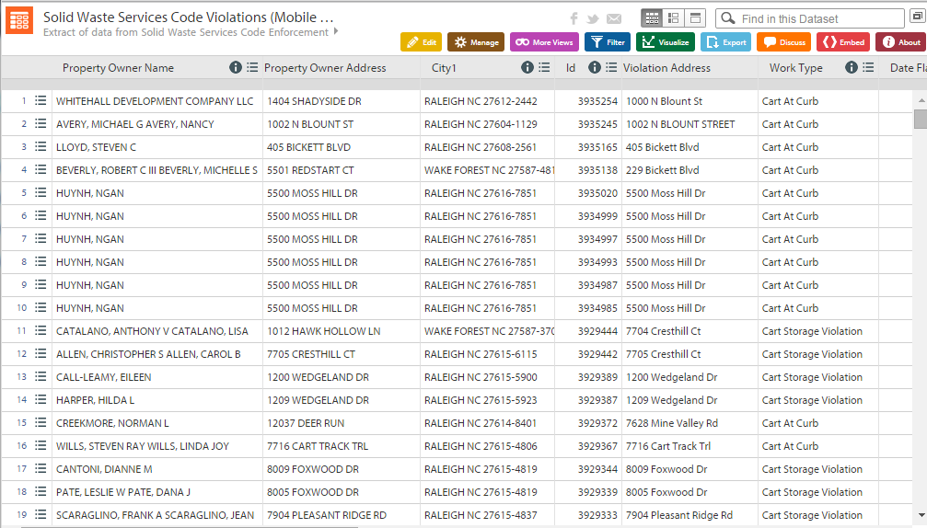
Data Integration to Improve Efficiency
Internal: SWS - Mobile 311
Usage / Value
Saves inspector from manual lookups for property owner addresses
Saves inspector from manual manipulation for bi-weekly mailings
Inspector Violations (Mobile 311)
Wake County Property
OR: ETL Service
Target Users
Solid Waste Service Inspectors (2)
Data Used
Inspector-collected Violation Data
Wake County Property Record Data
Notes:
Target Users
Solid Waste Service Inspectors (2)
Data Used
Inspector-collected Violation Data (Stored in 3rd Party App’s Cloud Database)
Wake County Property Record Data

Slide 17
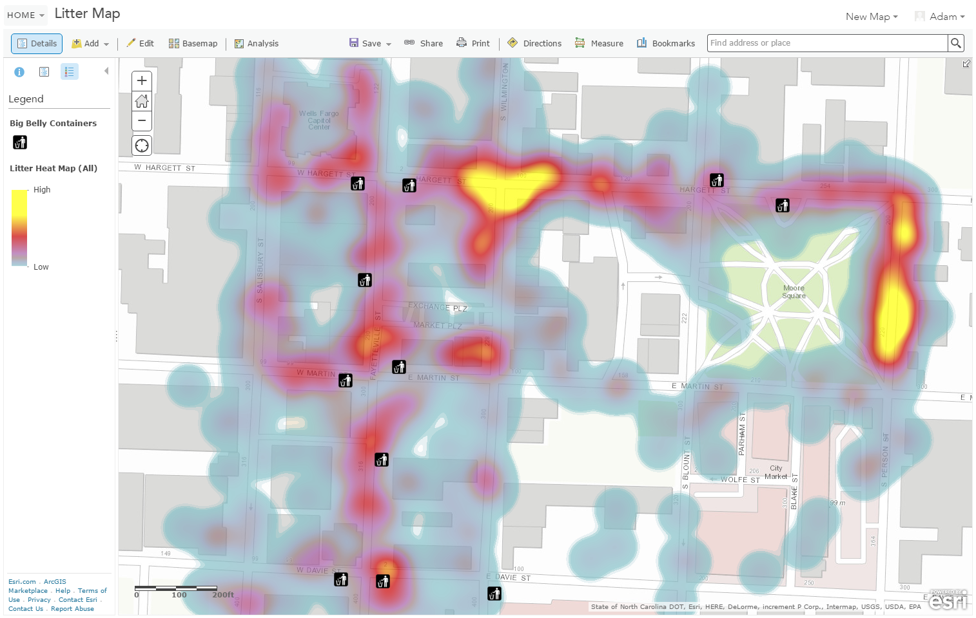
Sustainability Trash Audit
Big Belly Trash Cans
Notes:
Usage / Value
Clarified the problem for stakeholders and budget makers
Pointed to a clear solution
Target Users
Sustainability Team, Solid Waste Services
Data Used
Trash Collected during audit (built using custom app by IT)
Sustainability Program Assets (GIS layer)

Slide 18
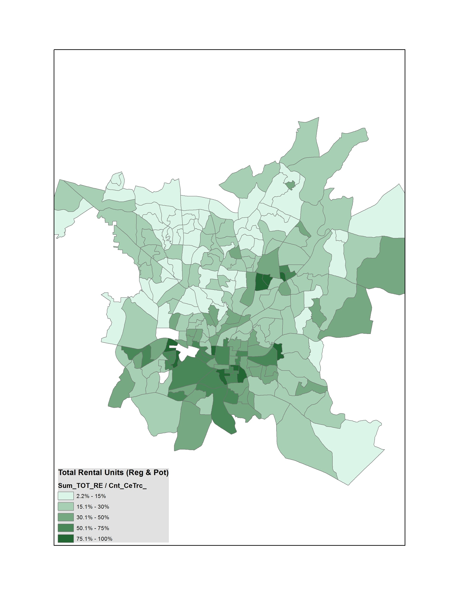
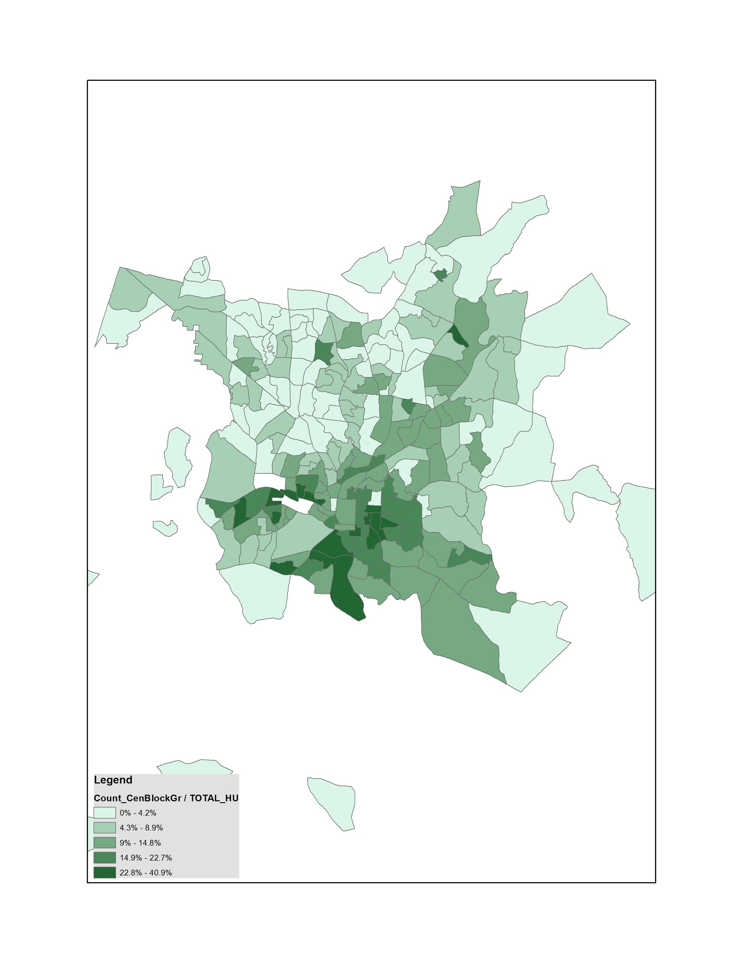
Data Analysis to Improve Data Quality
Internal: Housing - Rental Registry
Usage / Value
Policy Enforcement: Discovered 25% additional, high-probability rental units not currently in our database
Target Users
Housing Inspectors
Housing & Neighborhood Policy Makers
Data Used
Rental Registry
Wake County Property Record Data
Density of Total Rental Properties (2015) (Registered+Potential, % of Total Households by Block Group)
Application: http://maps.raleighnc.gov/remapping/
Source: Rental Registration Database per City of Raleigh HHs (Census 2010) Wake Property Records,
Notes:
Identified 2x the number of properties - potential 25% boost in effectiveness and revenue

Slide 19
Stormwater Strategic Mission
A Layman’s View
Public Safety
Property Damage
Water Quality
Stream Integrity
Outcomes & Impact
Phenomena
Stormwater Influences & Manages
Flooding
Normal Runoff
Illicit Discharges

Slide 20
A Layman’s View
Flooding
Normal Runoff
Illicit Discharges
Fixing
Preventing
Invest & Manage Capital Assets
That direct water flow
That filter water flow of contaminants before reaching natural streams
Monitor natural water systems and quality
Listen to citizen feedback on problem areas to fix
Inspect New Dev Plans & Sites
Spread awareness ab damaging practices & substances
Problems
Problems

Slide 21
Data Sharing - Process
Data Governance Check Point
Inventory & Share Internally
IT
Inside Dept.
Internal Stakeholders
Enrich & Expand (public release)
Targeted Community Input
Open Data (public releases)
Community Engagement
(Event or Project)
Data Release 1
Release 2 (Catalog)
Soft Public Release
Public Launch
Continual Qtly Process
* Stakeholder & Stories Workshop
* Data Inventory Workshop
* Publish “Low hanging fruit” internally
* Prioritize Stakeholder Stories
* Prioritize Datasets
* Add Metadata to Inventory
* Initial analysis of priority new datasets
* Share Catalog and Priorities with key public stakeholder groups; plan community engagement
* Ideate on stories / apps with public stakeholders
* Incorporate public feedback on useful structure of data
* Analyze/Clean priority datasets
* Automate (ETL)
* Communications & Engagement Plan
Notes:
Governance would include Departmental Directors or Business Division Owners (until such time that broader governance committee is established)

Slide 22
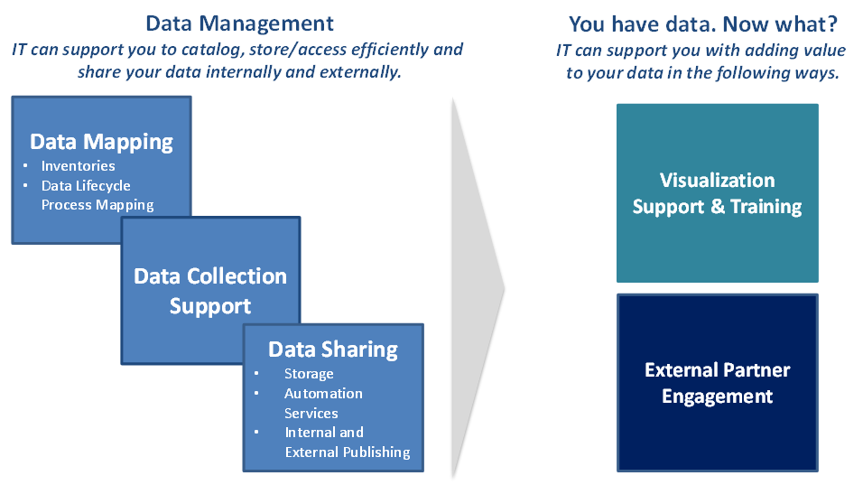
Open Data Program Services

Slide 23
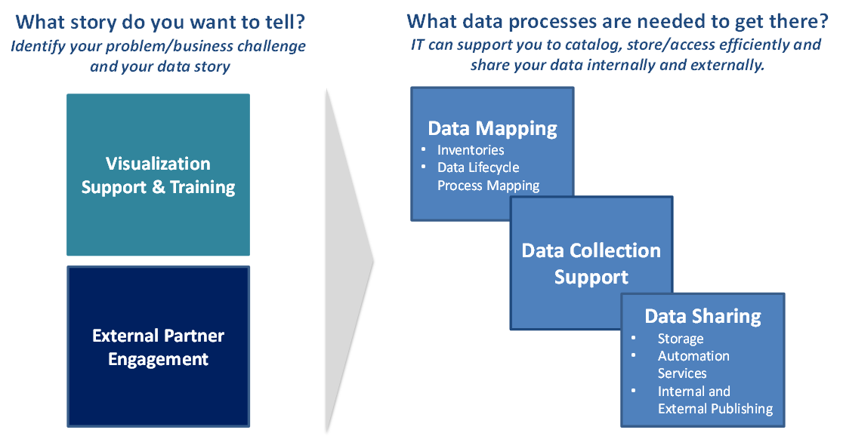
Open Data Program Services

Slide 24
Human-Centered Design
The discipline of
developing solutions in
the service of people
Credit: Luma Institute

Slide 25
Human-Centered Design
The discipline of
developing solutions in
the service of people
Credit: Luma Institute

Slide 26
Human-Centered Design
The discipline of
developing solutions in
the service of people
Credit: Luma Institute

Slide 27

Customer Centric
Notes:
Bezos - Empty Chair

Slide 28
Cost Savings
Once a system is in development, correcting a problem costs 10 times as much as fixing the same problem in design (concept). If the system has been released, it costs 100 times as much…
TOM GILB
SOFTWARE ENGINEER
AUTHOR OF “PRINCIPLES OF SOFTWARE
ENGINEERING MANAGEMENT”

Slide 29
Stormwater
Stakeholders & Stories

Slide 30
Ex. 1: Who are your stakeholders?
External
Internal
Volunteer Groups (Adopta Stream)
Stormwater Commission
City Council
City Manager’s Office
Public Works Dept.
Public Utilities Dept.
Planning (Permits)
Raleigh Property Owners Near Flooding (HOA Liaisons)
Raleigh Property Owners Near Rivers or Streams
Triangle Commuters through Areas of Flooding
State / Federal Gov
State - DEQ
US FEMA
US EPA
Triangle J Council of Government (TJCOG)
NC Department of Transportation (NCDOT)
University / Environmental Researchers
NC League of Municipalities
Industry professional associations - SWANC, APWA-NC, AWWA-WEA, other

Slide 31
Ex 1: Primary Relationships
Direct Beneficiaries
Acutely feel the impact of stormwater problems (e.g. are near project corridors) and are communicating to get resolution
Regulated Developers
People that “have to jump through your hoops” with up front time/investment to get their work done but appreciate when you help them avoid problems
Indirect Beneficiaries
Occasionally feel impact of Stormwater problems like flooding while driving after rains; Blind beneficiaries primarily of Stormwater prevention efforts

Slide 32
Ex 1: Primary Relationships
Volunteers and Advocates
People who are excited about your mission, especially around maintaining environmental quality and aquatic life
Operational Partners
People that you fund, direct or interact with on a daily or weekly basis in order to provide your core services
Oversight and Authorization
people that look at your work occasionally, judge your performance and decide your scope

Slide 33
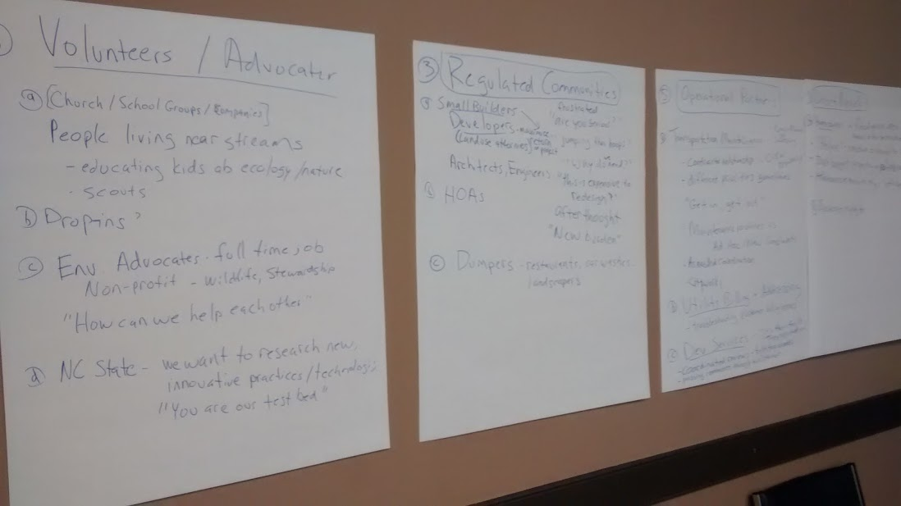

Slide 34
The Data Stack
Your desired stories can impact the whole stack
Our focus
Presentation
PDF Reports, Interactive Dashboards, Custom Apps, Embeds to Websites
Access Datasets
Structured Views [Internal vs External, API access]
Storage Data Sources
Relational Tables; Unstructured [Retention]
Collection (Digital) Software User Interfaces
Transactions, logs
[Ownership]
People and Activities
Not all activity is captured or stored digitally as data

Slide 35
CONCEPT IDEATION
Creative Matrix
A format for sparking new ideas at the intersections of distinct categories

Slide 36
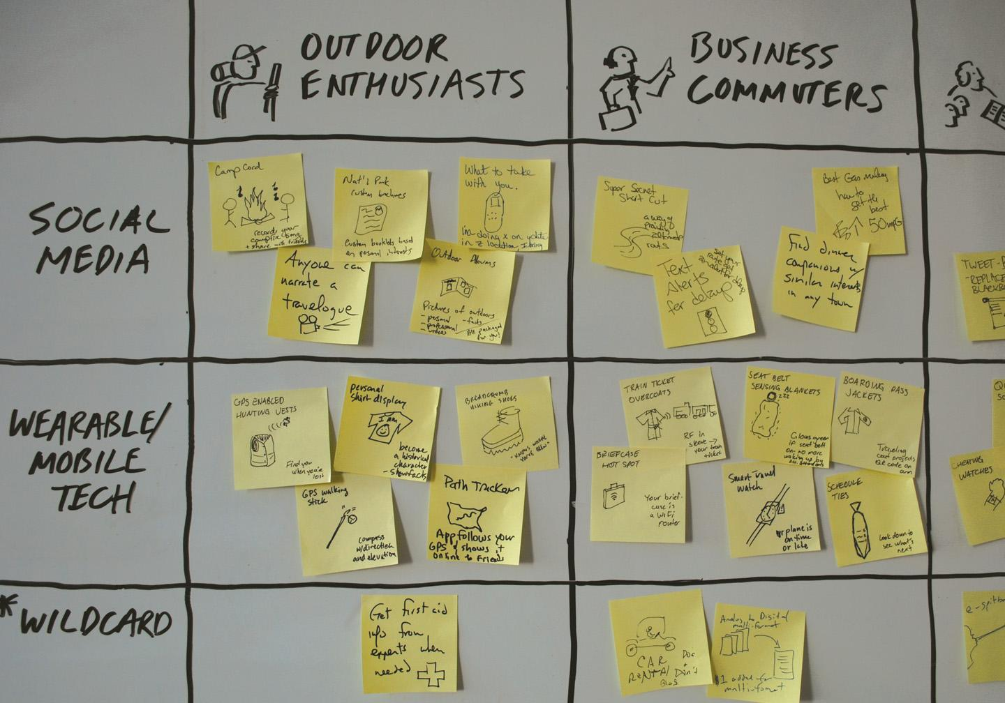
Notes:
In this project, a company specializing in traditional luggage wanted concepts for new products and services. The design team generated 107 ideas in 10 minutes.

Slide 37
CONCEPT IDEATION
Creative Matrix
Helps you generate a large number of ideas
Promotes divergent thinking
Helps you think of new and unusual ideas
Invites input from all team members

Slide 38
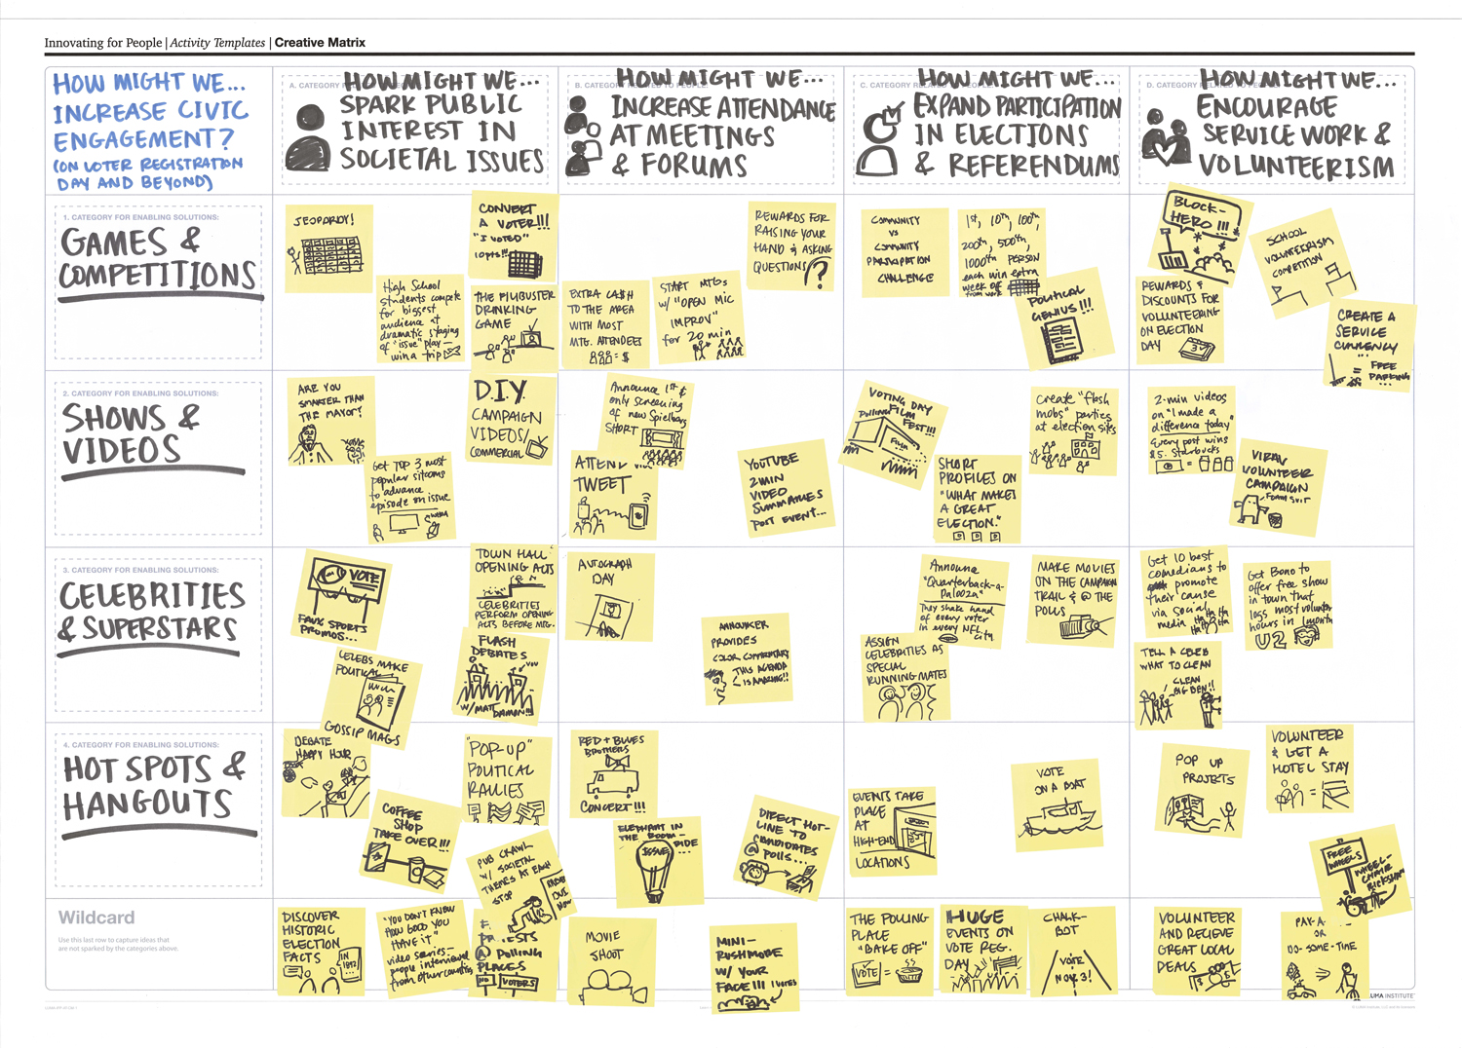
Exercise 2: Data Story Ideation
How might we...
improve awareness
improve lives

Slide 39


Guiding Principles of Data UX
🔎
Search First, Search Once
Meet People where they are
Embedded Insights (Raleigh Web, 3rd Party Apps)
Smart Alerting
Tell Stories around Strategic Themes
Operating / Capital Budget
Strategic Plan
Affordable Housing
Planning Process

Slide 40
Archetypal Stories
Overcoming the Monster | The Hunger Games, Independence Day
Apocalyptical | Apollo 13
Rags to Riches | Devil of Wall Street, Cinderella
The Quest | Indiana Jones, Lord of Rings
Voyage and Return | Alice in Wonderland, Goldilocks and the Three Bears, The Odyssey
Rebirth | Despicable Me, Beauty and the Beast
Source: Wikipedia

Slide 41
Add Movie Clips / Discussion

Slide 42
Our Data Stories
Overcoming the Monster
Describing the monster - 15 ft tall, eats 100 children per month
Slaying the monster - We made 1000s of arrows...
The Quest
A hero’s quest for something amazing (fountain of youth)
Or A hero’s tortured mission to achieve something, sometimes requiring a journey
The hero - The Developer, Stormwater Dept, Resident
The magnificent mission; the holy grail [Attention hook]
The journey/quest

Slide 43
Exercise 2: Data Story Ideation
How might we tell our story?
Direct Beneficiary
Regulated Developer
Operational Partner
Oversight
The Holy Grail
What’s the end game that I care about?
Describe the Monster
What problem are you solving that I care about?
Slaying the Monster
How does your work solve my problem?
Journey
Where have we been together?
Notes:
Direct Beneficiaries
Indirect Beneficiaries
Regulated Developers
Operational Partners
Volunteers and Advocates
Oversight and Authorization

Slide 44
Exercise 2: Data Story Ideation
How might we get our story out there...
Direct Beneficiary
Regulated Developer
Operational Partner
Oversight
Improve Search
What info do I come to you looking for?
Web and Mobile Applications
What apps and websites do I use where you could insert your data?
Embedding Viz in Third Party Websites
What websites do I go to? What info could you put there?
Strategic Story Campaign
What do you want me to know about you?
Notes:
Direct Beneficiaries
Indirect Beneficiaries
Regulated Developers
Operational Partners
Volunteers and Advocates
Oversight and Authorization

Slide 45
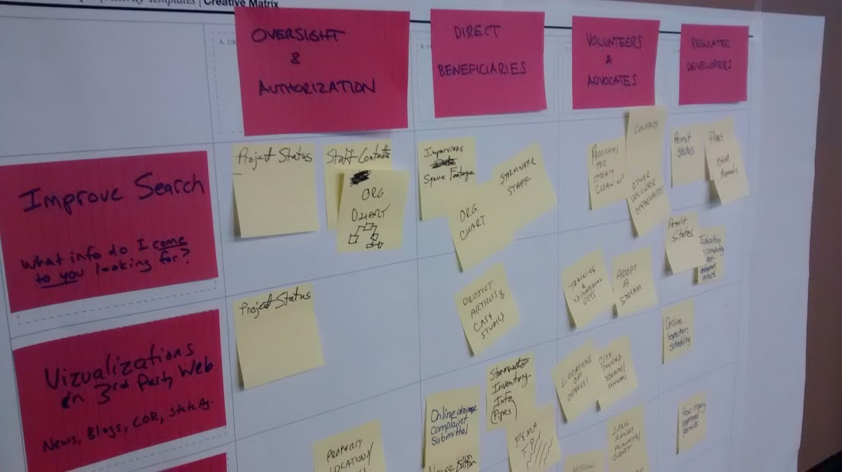

Slide 46
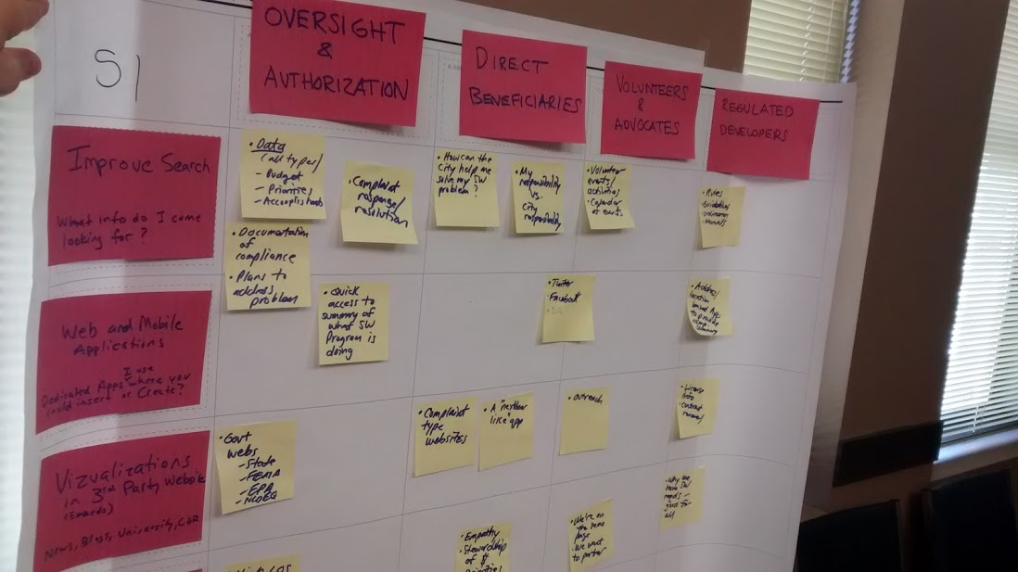

Slide 47
Summary: What’s your data story?
Oversight & Authorization - Grail: Our reporting is open and transparent, making your job easier. Monster: Delays in using/responding to data; Disruptions due to ad hoc reporting (inefficiencies in file mgt);
Direct Beneficiaries: Grail: We are highly responsive. Your problem is as important to us as to you. Journey: Change in customer perception about our responsiveness. Grail: everyone is comfortable why they are billed. Responsibilities/Process/Schedule/Status
Volunteers/Advocates: Your contributions have a meaningful impact on our community (we have it together). Volunteer hours ($ value), Calendar Event Info (what to bring; contact, wwww), Facebook Events, Adopt-A-Stream web map (not adopted)
Regulated Communities (Developers): Our activities prevent outcomes that are more costly than the review/inspection process / increase property values long term to neighborhoods.... [Property damage figures/ estimates]. Our process is collaboratively designed. Permit Status (alerts/SMS), Impact calculator/Why the process matter; Cost Diff btw LID/trad. Models; Doomsday 2030
Notes:
Live notes from the workshop exercise

Slide 48
Inventory Workshop
“A Write-a-thon”

Slide 49
Agenda
Intro (10 min) - Process, Metadata
Sprint 1 (20 min) - Sources of Data (Internal & External)
Big group
Sprint 2 (30 min) - List Out Datasets
Break into small groups
Break (10 min)
Sprint 3 (30 min) - Report Back & Continue to List Datasets
Representative from each group to report on progress, themes, questions
Sprint 4 (20 Minutes) - Instructions on Prioritization & Additional important metadata

Slide 50
The Data Stack
Our focus
Relevant Terms
Presentation
Metrics / Stories
PDF Reports, Interactive Dashboards, Custom Apps, Embeds to Websites
Access Datasets
Structured Datasets or Views [Internal vs External, API access]
Storage Data Sources
Relational Tables; Unstructured [Retention]
Collection (Digital) Software User Interfaces
Transactions, logs
[Ownership]
People and Activities
Not all activity is captured or stored digitally as data

Slide 51
The Data Stack
Your desired stories can impact the whole stack
Our focus
Relevant Terms
Presentation
PDF Reports, Interactive Dashboards, Custom Apps, Embeds to Websites
Access Datasets
Structured Datasets or Views [Internal vs External, API access]
Storage Data Sources
Relational Tables; Unstructured [Retention]
Collection (Digital) Software User Interfaces
Transactions, logs
[Ownership]
People and Activities
Not all activity is captured or stored digitally as data

Slide 52
Inventory Process
Initial Catalog
Prioritization
Metadata
Enrichment
Sources
Start
Publishing
Priority 1
Dataset Name
Source
Initial Overall Priority (1,2,3)
Currently Collected
Currently Open
Primary Team Responsible
Category, Keywords
Description (Key Fields)
Update Frequency
Level of Use
Sensitivity
Available Formats (Currently)
Level of Effort to Publish
Data Owner (BDirector)
Person Assigned To Complete Metadata
Primary Stakeholders
Geographic Coverage
Data Steward
Data Technical Point of Contact (if applicable)
Automation Candidate
Overall Dept Priority
Level of Use
Sensitivity
Level of Effort to Publish
Level of Effort to Contextualize
Strategic Alignment (KPIs)
Public Catalog
Filtered by; Currently Collected
Dataset Name
Source
Department
Category, Keywords
Description (Key Fields)
Update Frequency
Priority Level

Slide 53
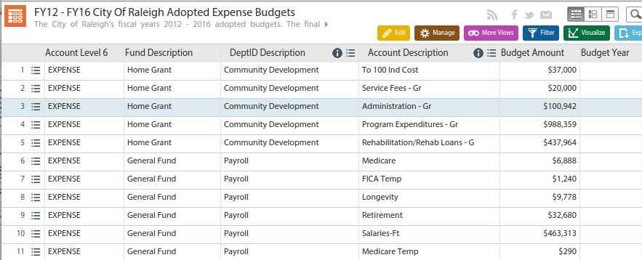
Metrics vs. Datasets
Measure | Total (2015) | Goal (2015)
Dollars Spent on Overtime in Public Works | $ 1,748,670 | $ 1,144,383
Metric
Overtime Spending 2015 Total
Aggregate report, filtered on focus area
Single figure (one attribute or row across one column variable like time)
Dataset
All Expenditures
Raw data, as granular as possible (with Timestamps, All Types, All statuses)
Many rows & columns

Slide 54
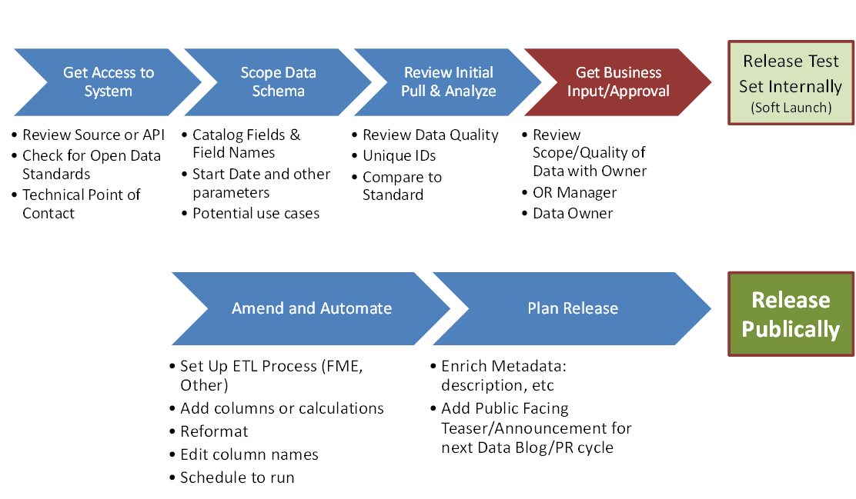
A Single Dataset Journey

Slide 55
Agenda
Intro - Process, Metadata
Sprint 1 (20 min) - Sources of Data (Internal & External)
Big group
Sprint 2 (30 min) - List Out Datasets
Break into small groups
Break (10 min)
Sprint 3 (30 min) - Report Back & Continue to List Datasets
Representative from each group to report on progress, themes, questions
Sprint 4 (Last 10 Minutes) - Instructions on Prioritization & Additional important metadata

Slide 56
Prioritization
Goal is to bucket into 1 (no more than 10), 2, or 3 waves of effort based on an overall weighted score or intuition.
1 | Demand | Validated Demand (External or Internal) | Higher scores where demonstrated demand from external parties or value estimated in cost savings or service quality improvements that data sharing would created.
2 | LOE-P | Level of Effort to Publish/Automate. | Level of additional effort required to clean data, as well as create a process for sharing with the IT Open Data team. E.g. Excel spreadsheets will require more difficulty.
3 | LOE-C | Level of Effort to Contextualize | Level of additional effort required to provide explanation around the data, i.e. perhaps requiring a microsite or lots of explanation or analysis to coincide a release.
3 | Strategic | Alignment with COR Strategic Plan or Key Data Story | This factor could be considered part of internal validation per factor 1, and/or would take precedence over other datasets competing for automation with limited resources.
4 | Urgency | Time-Sensitive Release? | If a strategic initiative relies on the release of certain datasets at a particular point in time. The nearer the deadline, the higher the score.

Slide 57
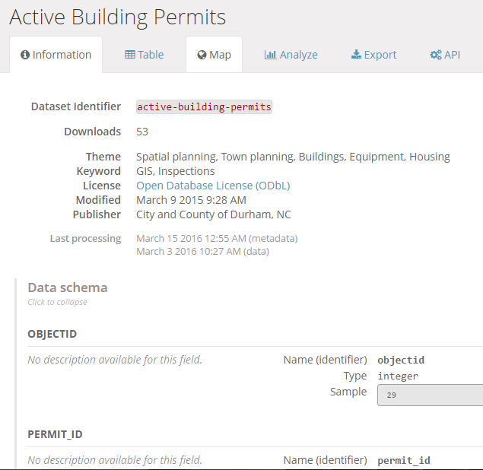
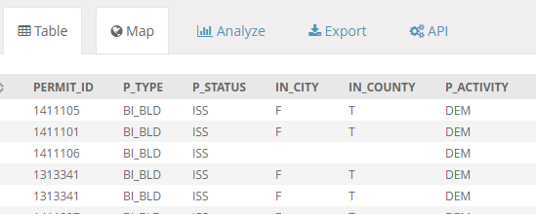
What is Metadata?
Discoverability
Clarity
Transportability

Slide 58
Key Metadata
Field | Description / Purpose
Dataset name | Brief descriptive name for the dataset. Meant to be transportable to a variety of catalogue contexts, inc search results.
Description | Include a brief description of the dataset. What is the purpose? What is it used for? Include key data fields if possible.
Publishing Department | What department collects and manages the data as an official record?
Category/Theme | When browsing, what categories would users of this data use to find this data and related data?
Tags/Keyword/Subject | Keywords that help with SEO and can be used as filter for users browse and discover the dataset they are looking for
Last updated | Date the dataset was most recently edited/re-published on the Portal
Geographic coverage | Does this data cover the whole city or a subset? Or does it have broader coverage than the city?
Frequency of data change | At what frequency does the information in the dataset get re-published?
Data Classification | PUBLIC, PROTECTED - this data is protected by law or regulation and can only be shared or accessed internally and per organizational procedures; OR this information includes individually identified information; SENSITIVE - in its raw form, this data poses security concerns, could be misused to target individuals or poses other concerns.
License/use constraints | What license would you like external parties to use this under? E.g. Creative Commons 1.0? Which requires attribution to Publisher?

Slide 59
A Good “Description”
[Brief Glance: two sentence description including what’s each row represents, data ranges and how often it’s updated.]
This dataset includes all reported issues using the See Click Fix (SCF) application, both on the web and through the mobile application, from June 28, 2013 to current date. This dataset is updated daily.
[The Why? Add key context about how the data gets generated and how it is used in the city that gives it meaning to people not familiar with your business detailed processes.]
The SCF service allows citizens to report issues to the City which then, in many cases automatically gets routed to the appropriate department within the City, and in other cases gets handled by the Office of the City Manager.
[Longer explanation: Include more detailed information, caveats about the data quality, details about the business processes, web links to other relevant context.]
More about the data:
The City of Raleigh officially began using the SCF application on June 28, 2013 as an interface for citizens to report issues. Hence, we are reporting data since that time. However, long-time citizens would know that through support from WRAL started using the service to track issues as early as 2010. Additional data on reported issues prior to June 28, 2013 can be searched for here: https://seeclickfix.com/raleigh.
Developers can also access the full dataset here: http://dev.seeclickfix.com/
Some reported issues may fall outside the jurisdiction of the city. For example, issues like potholes reported on roads that are maintained by the State Department of Transportation still need to be reported to the NC DOT. Therefore those issues would be automatically closed through the See Click Fix reporting system.

Slide 60
Legally Protected vs. Sensitive
Legally protected
No gray area - never release
Must sanitize from open datasets
E.g. HIPAA, FERPA, state laws, etc.
Sensitive
Some gray area - sometimes don’t release (if can be reconstructed via mosaic effect)
May sanitize from open datasets
Ways to anonymize personally identifiable info - aggregating, sanitizing, etc.
E.g. victims in police reports, social services not related to health, etc.

Slide 61
Types of Metadata
Administrative metadata is the most common and is produced in data collection, production, publication, and archiving.
Structural metadata describes a dataset’s structure, including its format, organization, and variable definitions. This is highest in demand by researchers and academics.
Reference/descriptive metadata is a broad term that mostly involves descriptions of methodology, sampling, and quality. How did you arrive at this data?
Behavioral metadata records to the reactions and behaviors of the dataset’s users such as a rating or user analytics.

Slide 62
Sources & Systems
LINK
http://bit.ly/ralstormdatainv

Slide 63
Data Sources - Brainstorm
What data sources does your department maintain? Where are you the official source of record?
What data is reported to federal, state or local agencies?
What departmental data is currently publicly available on Data.RaleighNC.Gov or elsewhere online?
What data populates your monthly or quarterly reports? Do you use for internal performance and trend analysis?
What data has been requested under FOIA? Talk with the Public Affairs Officers (David Blount)
What data do other departments ask you for?
What kinds of open data are similar agencies publishing across the country?

Slide 64
Datasets - Brainstorm
Data you own
What data sources does your department maintain? Where are you the official source of record?
What data is reported to federal, state or local agencies?
What departmental data is currently publicly available on Data.RaleighNC.Gov or elsewhere online?
What data populates your monthly or quarterly reports? Do you use for internal performance and trend analysis?
What data has been requested under FOIA? Talk with the Public Affairs Officers (David Blount)
What data do other departments ask you for?
What kinds of open data are similar agencies publishing across the country?

Slide 65
Data Standards?
EPA for Lab Analysis / Sampling Methods
FEMA for Elevation Certificates
ANSI for building/construction reports
CAFR / GASB for budgeting/financial reports

Slide 66
Datasets Brainstorming Prompts
By Source
By Data Story
By Program or Group
By Report

Slide 67
Parking Lots
Data you need / consume
What applications or systems do you currently use to access data?
What data do consultants ask for?
Where do you get stuck when filling out reports / surveys?

Slide 68
Where we go from here
Prioritization
Complete Inventory Metadata
Visions for End Game

Slide 69
Apps: What other cities doing?
MD BayStat
http://baystat.maryland.gov/causes-of-the-problems-map/
Maryland Data Bay Challenge
San Francisco: Adopt-A-Drain
https://adoptadrain.sfwater.org/

Slide 70
Appendix

Slide 71

Your sherpa
10+ years at intersection of technology, government, and innovation
Data Geek: Open data program - City of Raleigh
Civic Volunteer: Co-leads Code for Durham, a local volunteer brigade of the non-profit Code for America. .
Entrepreneur: Advised the National League of Cities on the 2015 Multi-City Innovation Campaign, an experimental kick-starter style program backed by twenty local governments to spur civic innovation leading to 25% adoption of new technologies.
3+ years in India leading sales and the Mumbai office of ZipDial, an early stage, venture-backed mobile marketing startup. Sold to Twitter in 2015.
Technology Consultant w/ Gov Experience: Started career as a technology strategy consultant for Fortune 500 companies at inCode, a consulting group within VeriSign, Inc, based in Washington, D.C. Then led investment analysis for over $550 million in broadband infrastructure projects at the U.S. Department of Commerce's Broadband Technology Opportunities Program.
Adam J Martin
@techfrogg

Slide 72
PARTICIPATORY RESEARCH
What’s on Your Radar?
An exercise in which people plot items according to personal significance

Slide 73
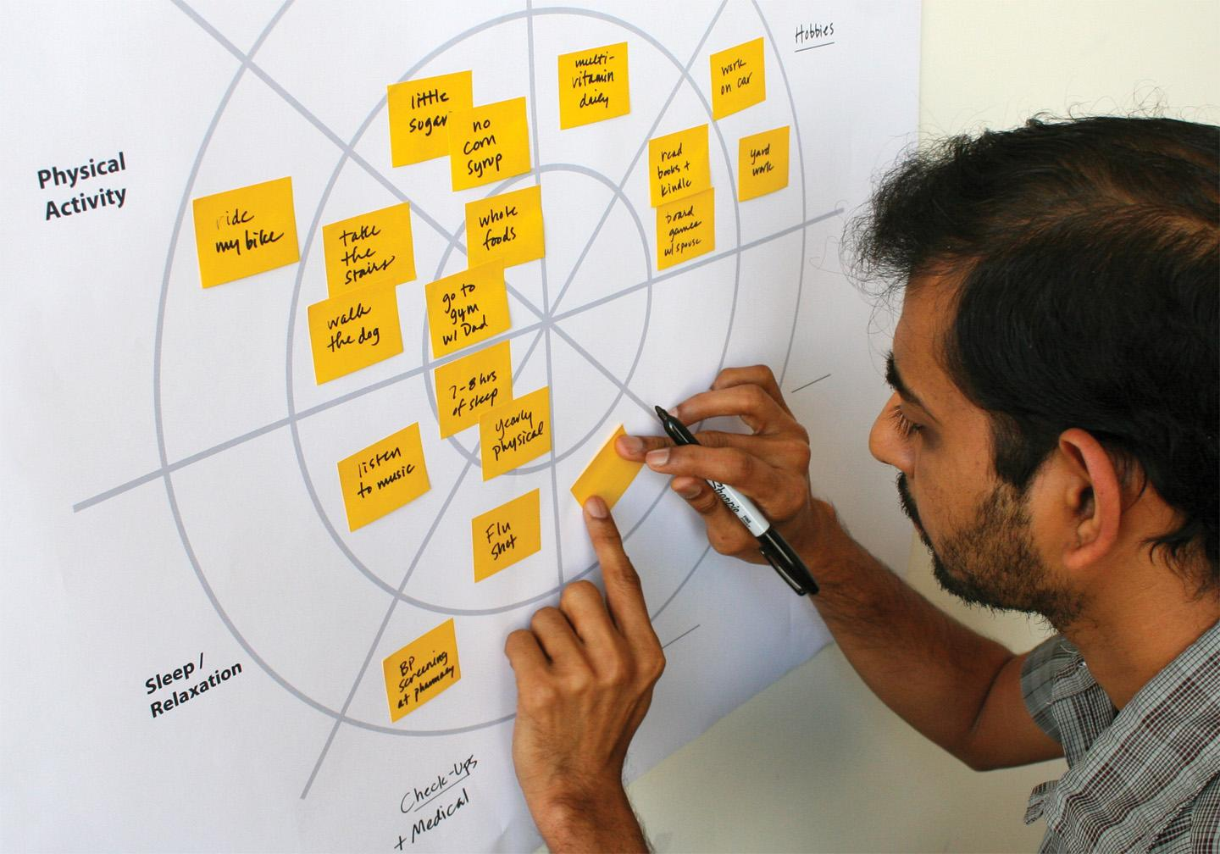
Notes:
In this example, a student was invited to plot his personal health habits. His responses were combined with others and used to inform the design of a new wellness program.

Slide 74
PARTICIPATORY RESEARCH
What’s on Your Radar?
Reveals what people are thinking
Shows how people prioritize
Challenges your preconceptions
Yields documents that inform ensuing work

Slide 75
The Data Stack
Strategic Planning
Wisdom
Conversation
Knowledge
Presentation
Info
Dataset Access
Data
Storage Data Sources
Digital Collection Software User Interfaces

Slide 76
Can you find it? Exercise
Which publicly managed Electric Vehicle station gets used the most in Raleigh?
What Parking Meter collects the most revenue?

Slide 77
Open Data Discussion
Intro to Open Raleigh
What have we done?
What can be done?
Tool Demos
Socrata - Finding, Browsing Creating Views
ArcGis Online - Adding Data
What’s Your Story?
Discussion on how we can help
Notes:
Introductions
Intro to Data Management
What we do? Services
What can be done?
Datalens
Showcase fun results from world GIS and Dataviz (internal & external)
How does “open” data fit into all of this?
What’s Your Story?
Envisioning your end game
Who are your audiences?
What do they want to know? top 10 requests
What do you want them to know? top 3 messages
Data Inventories
How to structure Data?

Slide 78
Open Data - Started with iMaps...
2005 - GIS Collaboration launching iMaps (addresses, parcel boundaries)
2010 - Refreshed iMaps Raleigh developed it; County has support (Help Desk/Trainings)
2011 - City Council Proposes Open Source Resolution
2012 Feb: Resolution Adopted Unanimously
2013 Mar: Open Data Portal Launch
iMaps
2.9 million page views
660,000 total users
40,000 users p.m.
10 min per session
* Metrics averages Mar 2013 - Mar 2015
maps.raleighnc.gov/imaps/

Slide 79
People want data
Who are your data customers?
Apps: Waze, Google Maps, local
~30 million rows of data consumed per month by applications**
Downloads per month
900+ Custom Views created
1.5 million page views
13,000 page views per month
* Since March 2013 ** 6 month trailing avg
^ Updated 15 July 2015, across https://Data.RaleighNc.gov + http://data.ral.opendata.arcgis.com/
Notes:
1,800 visitors per month

Slide 80
Why Open Data?
Cultivating a culture of turning data into knowledge which leads to:
Better Decisions
Increased Quality
of Life
Efficient City
Services
New Business Models

